Slide 1

Software Project Management
Dr. Sumaira Nazir
Department of Software Engineering
National University of Modern Languages, Islamabad

Slide 2
Project Schedule Management-Network Diagrams

Slide 3
Network Diagrams
technique for showing activity sequencing
a schematic display of the logical relationships among project activities and their sequencing.

Slide 4
Elements of Network Diagrams
Letters A through Z
represent activities with dependencies that are required to complete the project.
These activities come from the WBS and activity definition process described earlier.
Arrows
represent the activity sequencing or relationships between tasks
For example, Activity A must be done before Activity D, and Activity D must be done before Activity H.

Slide 5
AOA/ADM
Activity-on-arrow (AOA) approach or the arrow diagramming method (ADM)
a network diagramming technique in which activities are represented by arrows and connected at points called nodes to illustrate the sequence of activities.

Slide 6
AOA/ADM
A node is simply the starting and ending point of an activity. The first node signifies the start of a project and the last node represents the end.

Slide 7
Project Schedule Management-Network Diagrams-AOA

Slide 8
Steps to create an AOA network diagram
Step 1:
Find all of the activities that start at Node 1.
Draw their finish nodes, and draw arrows between Node 1 and each of the finish nodes.
Put the activity letter or name on the associated arrow.
If you have a duration estimate, write it next to the activity letter or name, as shown in Figure 1.
For example, A = 1 means that the duration of Activity A is one day, week, or other standard unit of time.
Be sure to put arrowheads on all arrows to signify the direction of the relationships.

Slide 9
Steps to create an AOA network diagram
Step 2:
Continue drawing the network diagram, working from left to right.
Look for bursts and merges.
Bursts occur when two or more activities follow a single node.
A merge occurs when two or more nodes precede a single node.
For example, in Figure 1,
Node 1 is a burst because it goes into Nodes 2, 3, and 4.
Node 5 is a merge preceded by Nodes 2 and 3.

Slide 10
Steps to create an AOA network diagram
Step 3:
Continue drawing the AOA network diagram until all activities are included.

Slide 11
Steps to create an AOA network diagram
Step 4:
As a rule of thumb, all arrowheads should face toward the right, and no arrows should cross on an AOA network diagram.

Slide 12
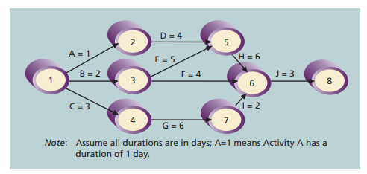
AOA

Slide 13
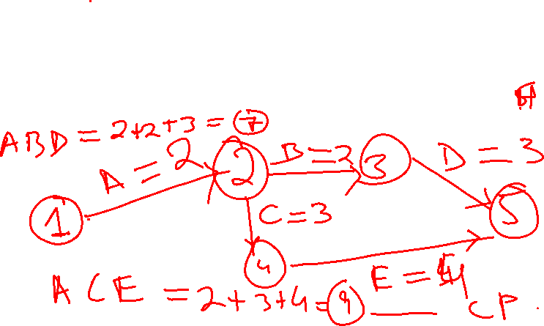
AOA-Example
Activity | Initial Node | Final Node | Estimated Duration
A | 1 | 2 | 2
B | 2 | 3 | 2
C | 2 | 4 | 3
D | 3 | 5 | 3
E | 4 | 5 | 4

Slide 14
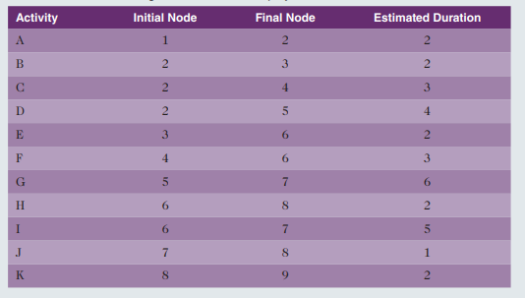
Class Activity
Draw AOA.

Slide 15
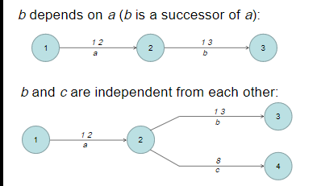
AOA-Dependency Rule

Slide 16
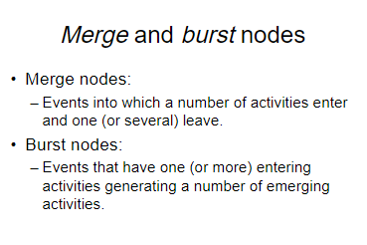
Consequences of Dependency Rules

Slide 17
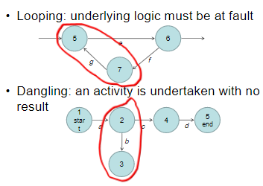

Slide 18
Program Evaluation and Review Technique-PERT
When there is a high degree of uncertainty about the individual activity duration estimates
Program Evaluation and Review Technique (PERT) can be used to estimate project duration.

Slide 19
Program Evaluation and Review Technique-PERT
PERT uses probabilistic time estimates—duration estimates based on using
Optimistic: less than actual time
most likely: actual time spent/without applying PERT
Pessimistic: with added delay
estimates of activity durations—instead of one specific or discrete duration estimate, as CPM does

Slide 20
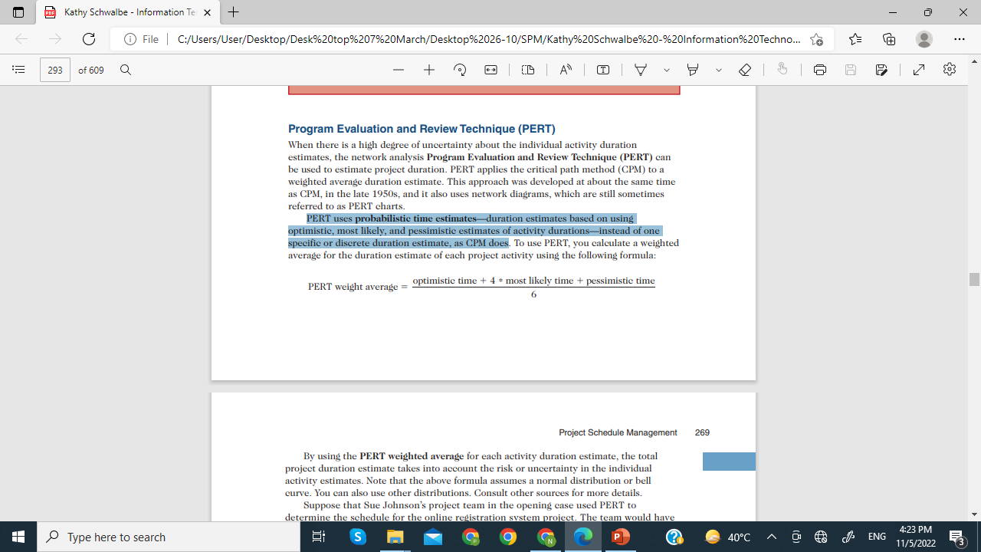
Program Evaluation and Review Technique-PERT

Slide 21
Program Evaluation and Review Technique-PERT
Activities | Most likely time | Optimistic Time | Pessimistic Time | Estimated Duration
A | 05 | 03 | 07 | ?
B | 10 | 12 | 15 | ?
C | 4 | 2 | 6 | ?
3 + 4 * 05 +07
6
A---- 5 DAYS
B----? C----?

Slide 22
Program Evaluation and Review Technique-PERT
Activities | Most likely time | Optimistic Time | Pessimistic Time
A | 05 | 03 | 07
B | 10 | 12 | 15
C | 4 | 2 | 6
3 + 4 * 05 +07
6
A---- 5 B------11 DAYS APPROX
C----? 4 DAYA

